Slide 1
WORLD OF DRONE
Drone Components: Flight Stack (Autopilot Software)

Slide 2
Flight Stack
UAV software called the flight stack or autopilot.
UAVs are real-time systems that require rapid response to changing sensor data.

Slide 3
Flight Stack
Examples include RaspberryPis, Beagleboards, etc. shielded with NavIO, PXFMini, etc.
Or designed from scratch such as Nuttx, preemptive-RT Linux, Xenomai, Orocos-Robot Operating System or DDS-ROS 2.0.

Slide 4
Loop Principles
UAVs employ open-loop, closed-loop or hybrid control architectures.

Slide 5
Open Loop
It provides a positive control signal (faster, slower, left, right, up, down) without incorporating feedback from sensor data.

Slide 6
Closed Loop
It incorporates sensor feedback to adjust behavior (reduce speed to reflect tailwind, move to altitude 300 feet).

Slide 7
Closed Loop
The PID controller is common. Sometimes, feed forward is employed, transferring the need to close the loop further.

Slide 8
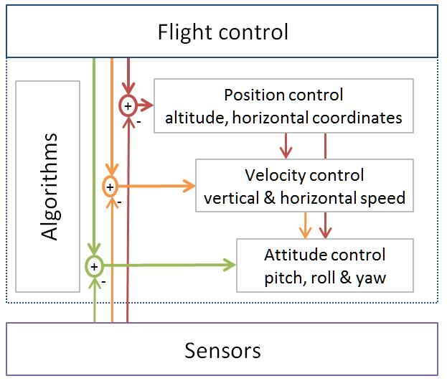
Closed Loop
Typical flight-control loops for a multirotor

